Slide 1
Messaging and Queuing - Sorting Objects
Bălgradean Andrei-Laurențiu

Slide 2
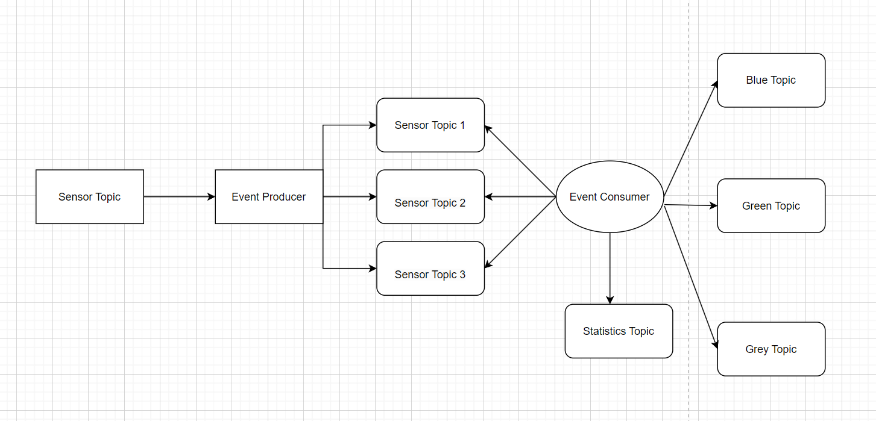

Architecture

Slide 3
Event PRoducer
Defines and Constructs the ProducerRecord
Send the data to the server as a JSON string
Provides randomness for making the events

Slide 4
Event COnsumer
In a continuous loop searches for items to consume
Deserielaizez the messages and parses the JSONS
Provides a statistics found at the different topic

Slide 5
Main.java
Establishes Kafka server, topics partitions
Makes sure everything is set up for Producers and Consumers
Checks for running threds and stops if they are no longer in use

Slide 6




Thank you
Bălgradean Andrei-Laurențiu

